Slide 1
CS312
Artificial Intelligence
Lecture # 04
HITEC University, Taxila
Mr. Mubashir Iqbal
Fall-2025

Slide 2
Lecture Content
Time Complexity and Space Complexity
Uninformed Search Algorithms:
  Breadth First Search (BFS)
  Depth First Search (DFS)
  Depth Limited Search
  Iterative Deepening Depth First Search.
  Uniform Cost Search
  Bidirectional Search

Slide 3
Time Complexity
Time Complexity measures how much time an algorithm takes to complete as the input size increases.
It is expressed as a mathematical function of the input size (n). It helps us compare algorithms based on their efficiency — how fast they solve a problem.
Simple Explanation
Time complexity tells us how the running time of an algorithm grows when we give it more data to process.
For example:
  Sorting 10 numbers takes 1 second.
  Sorting 1,000 numbers might take 100 seconds. The rate of increase in time shows the time complexity.

Slide 4
Time Complexity
Why It Matters
Helps developers predict performance before running the code.
Important for optimization in AI, data science, and cybersecurity applications.
Allows fair comparison between different algorithms (e.g., BFS vs DFS).
Algorithm | Time Complexity | Description
BFS | O(V + E) | Visits each vertex and edge once
DFS | O(V + E) | Same as BFS, but different traversal order
Uniform Cost Search | O(E + V log V) | Uses priority queue (depends on cost)
A* | O(b^d) worst-case | Depends on branching factor and depth

Slide 5
Space Complexity
Space Complexity measures the total amount of memory an algorithm needs to execute completely.
It includes all memory used for:
  Input data
  Variables and constants
  Temporary data structures (like queues, stacks, recursion memory)
  Function call overhead
Simple Explanation: Space Complexity tells us how much memory (RAM) an algorithm needs as the input size grows.
Example:
  A simple addition program that adds two numbers → needs constant memory (O(1)).
  BFS algorithm → needs large memory to store all visited nodes in a queue.

Slide 6
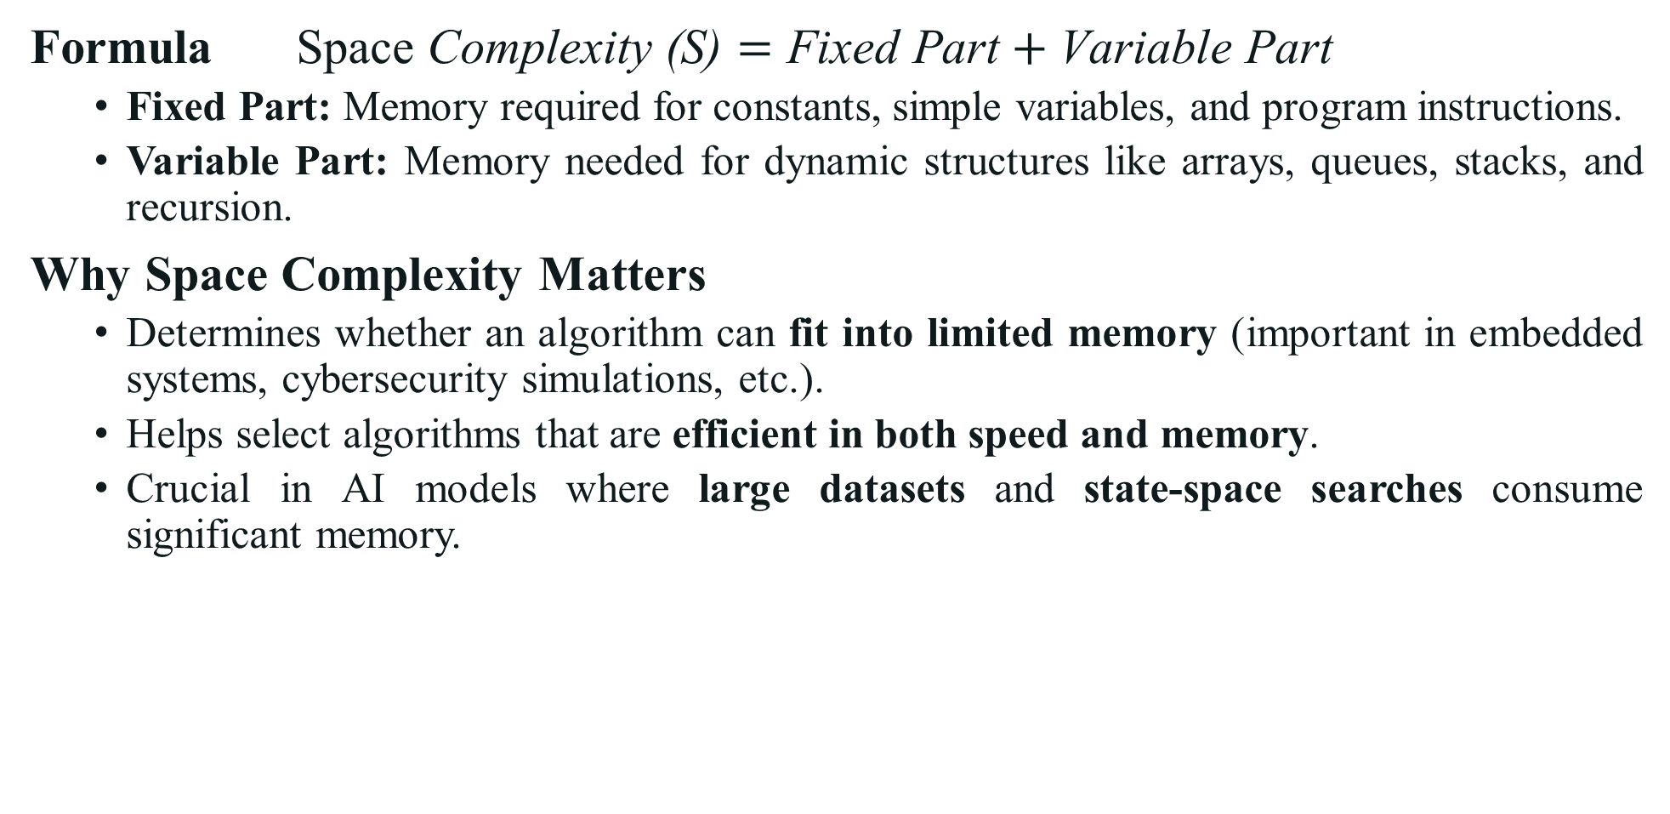
Space Complexity
Formula $\text{Space} \text{Complexity}\text{ (}\text{S}\text{)}=\text{Fixed} \text{Part}+\text{Variable} \text{Part}$
  Fixed Part: Memory required for constants, simple variables, and program instructions.
  Variable Part: Memory needed for dynamic structures like arrays, queues, stacks, and recursion.
Why Space Complexity Matters
  Determines whether an algorithm can fit into limited memory (important in embedded systems, cybersecurity simulations, etc.).
  Helps select algorithms that are efficient in both speed and memory.
  Crucial in AI models where large datasets and state-space searches consume significant memory.
Algorithm | Space Complexity | Reason
BFS | O(bᵈ) | Must store all nodes at each level (uses a queue).
DFS | O(b·m) | Stores only the path + unexpanded nodes (uses a stack/recursion).
Uniform Cost Search | O(bᵈ) | Stores frontier nodes in a priority queue.
A* | O(bᵈ) | Keeps all nodes in memory for path-cost comparison.

Slide 7
Breadth First Search (BFS)

Slide 8
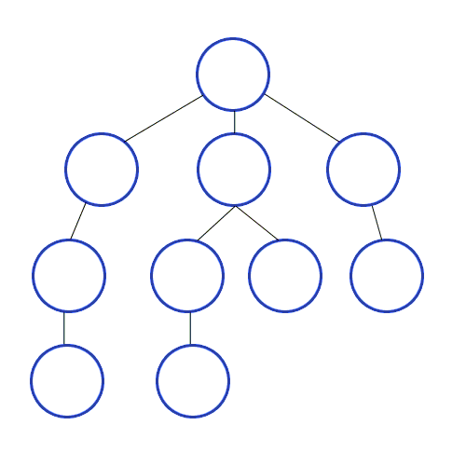
1. Breadth First Search (BFS)
Breadth First Search (BFS) is a graph traversal algorithm that explores nodes level by level.
It starts from a selected node, called the root or starting point, and visits all its immediate neighbors before moving on to the next level of neighbors.
BFS uses a queue data structure to keep track of nodes that need to be explored. As each node is visited, its unvisited neighbors are added to the queue.
This process continues until all reachable nodes are visited.
BFS is especially useful for finding the shortest path in unweighted graphs because it guarantees that the first time a node is reached, it is through the shortest possible route.

Slide 9
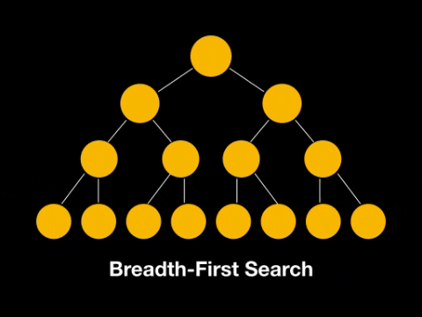
1. Breadth First Search (BFS)
How BFS Works (Step-by-Step)
  Start from the initial node.
  Add it to a queue.
  While the queue is not empty:
  Remove the front node.
  Visit it.
  Add all its unvisited neighbors to the queue.
Benefits of BFS
  Finds the shortest path in unweighted graphs.
  Easy to implement. Simple and systematic.
  Useful for level-order traversal in trees.

Slide 10
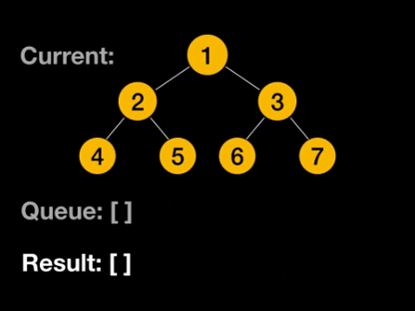
1. Breadth First Search (BFS)
Disadvantages
  Requires more memory (queue may grow large).
  Slower for deep or infinite search spaces.
  Not suitable for problems where the solution is far from the root.
BFS in Computer Science
  Social networks: Finding shortest connection between two people.
  Web crawlers: Exploring websites level by level.
  GPS systems: Finding shortest route in road maps.
  AI games: Exploring possible moves in game trees.

Slide 11
1. Breadth First Search (BFS)
Time and Space Complexity
(V = number of vertices, E = number of edges)
Time Complexity: O(V + E)
Space Complexity: O(V) (Stores all nodes at a level in memory)

Slide 12
1. BFS - Example: Simple Graph Search
Graph Representation
Goal: Perform BFS starting from node A
A
B
C
D
E
F
G

Slide 13
1. BFS - Example 1: Simple Graph Search
Step | Queue (FIFO) | Visited Order | Explanation
1 | [A] | — | Start with A
2 | [B, C, D] | A | Add A’s neighbors
3 | [C, D, E, F] | A, B | Explore B’s neighbors (E, F)
4 | [D, E, F, G] | A, B, C | Explore C (no new neighbors)
5 | [E, F, G] | A, B, C, D | Explore D → Add G
6 | [F, G] | A, B, C, D, E | Explore E
7 | [G] | A, B, C, D, E, F | Explore F
8 | [] | A, B, C, D, E, F, G | Explore G (no new nodes)
A
B
C
D
E
F
G
Final BFS Traversal: A → B → C → D → E → F → G

Slide 14
Complex Question: Breadth-First Search (BFS)
Consider the following unweighted graph:
Perform Breadth-First Search (BFS) starting from node A.
You are required to:
  Write the order of node traversal (Visited order).
  Show the queue contents at each step.
  Determine the shortest path from A to K.
A
B
C
D
E
F
G
H
I
J
K
L
M

Slide 15
Complex Question: Breadth-First Search (BFS)
Initial Setup: Start node: A, Queue = [A], Visited = {}
Final BFS Traversal Order: A → B → C → D → E → F → G → H → I → J → K → L → M
A
Step | Current Node | Queue (Before Dequeue) | Visited Order | Newly Enqueued Nodes
1 | A | [A] | A | B, C, D
2 | B | [B, C, D] | A, B | E, F
3 | C | [C, D, E, F] | A, B, C | G
4 | D | [D, E, F, G] | A, B, C, D | H
5 | E | [E, F, G, H] | A, B, C, D, E | I, J
6 | F | [F, G, H, I, J] | A, B, C, D, E, F | —
7 | G | [G, H, I, J] | A, B, C, D, E, F, G | K
8 | D | [H, I, J, K] | (Already visited) | —
9 | H | [I, J, K] | A, B, C, D, E, F, G, H | L, M
10 | I | [J, K, L, M] | A, B, C, D, E, F, G, H, I | —
11 | J | [K, L, M] | A, B, C, D, E, F, G, H, I, J | —
12 | K | [L, M] | A, B, C, D, E, F, G, H, I, J, K | —
B
C
D
E
F
G
H
I
J
K
L
M

Slide 16
Complex Question: Breadth-First Search (BFS)
Shortest Path from A to K
Shortest Path: A → C → G → K
A
Step | Current Node | Queue (Before Dequeue) | Visited Order | Newly Enqueued Nodes
1 | A | [A] | A | B, C, D
2 | B | [B, C, D] | A, B | E, F
3 | C | [C, D, E, F] | A, B, C | G
4 | D | [D, E, F, G] | A, B, C, D | H
5 | E | [E, F, G, H] | A, B, C, D, E | I, J
6 | F | [F, G, H, I, J] | A, B, C, D, E, F | —
7 | G | [G, H, I, J] | A, B, C, D, E, F, G | K
8 | D | [H, I, J, K] | (Already visited) | —
9 | H | [I, J, K] | A, B, C, D, E, F, G, H | L, M
10 | I | [J, K, L, M] | A, B, C, D, E, F, G, H, I | —
11 | J | [K, L, M] | A, B, C, D, E, F, G, H, I, J | —
12 | K | [L, M] | A, B, C, D, E, F, G, H, I, J, K | Goal Reached!
B
C
D
E
F
G
H
I
J
K
L
M

Slide 17
Depth First Search (DFS)

Slide 18
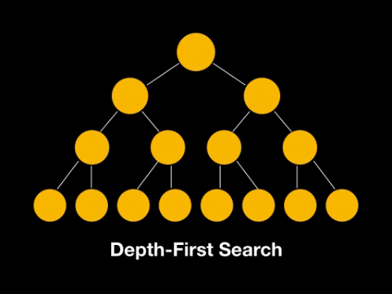
2. Depth First Search (DFS)
Depth First Search (DFS) is an uninformed search algorithm that explores as far as possible along each branch before backtracking. It uses a stack (LIFO) structure, either explicitly (with a stack data structure) or implicitly via recursion.
Working Principle
Start from the initial (root) node.
Visit the unvisited adjacent node and mark it as visited.
If no adjacent unvisited node exists, backtrack to the previous node.
Repeat the process until the goal is found or all nodes are explored.

Slide 19
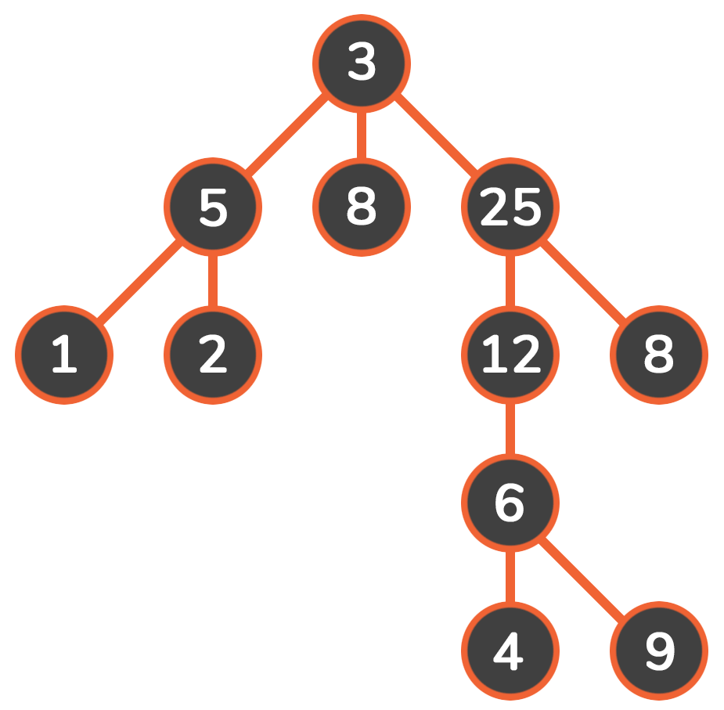
2. Depth First Search (DFS)
Advantages
  Uses less memory than BFS (stores only one path).
  Can find a solution without exploring all nodes (if goal is deep).
Disadvantages
  May get stuck in an infinite loop in cyclic graphs.
  Not optimal — may find longer path first.
  Not complete — might miss the goal if depth limit not set.
Applications
  Solving mazes or puzzles (like N-Queens).
  Pathfinding in AI (where full exploration is required).
  Topological sorting and cycle detection in graphs.
  Backtracking problems (e.g., Sudoku, crosswords).

Slide 20
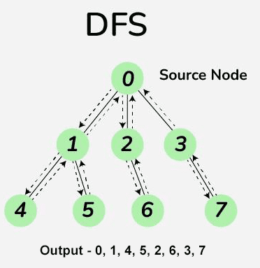
2. Depth First Search (DFS)
Time and Space Complexity
Let:
  b = branching factor (number of children per node)
  d = depth of the goal node
  m = maximum depth of the search tree
Then:
  Time Complexity: O(bᵐ)
  Space Complexity: O(b*m)

Slide 21
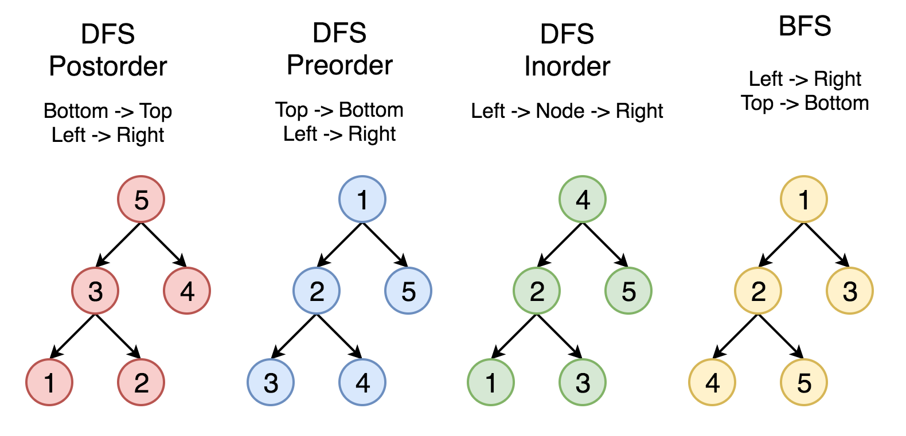
2. Depth First Search (DFS)
Traversal
Traversal in a Binary Search Tree (BST) is the process of visiting each node in the tree exactly once in a systematic order.
Since trees are non-linear, there are several ways to traverse them, with common methods including in-order, pre-order, and post-order (all depth-first traversals).
1. Pre-Order
  Order: Root, Left, Right
  Process: Visit the current node first, then recursively traverse the left subtree, and finally the right subtree.
  Use case: Useful for creating a copy of the tree or for prefix notation in expression trees.

Slide 22
2. Depth First Search (DFS)
Traversal
2. In-Order
  Order: Left, Root, Right
  Process: Recursively traverse the left subtree, then visit the current node, and finally the right subtree.
  Use case: For a Binary Search Tree (BST), in-order traversal visits the nodes in ascending order.

Slide 23
2. Depth First Search (DFS)
Traversal
3. Post-Order
  Order: Left, Right, Root
  Process: Recursively traverse the left subtree, then the right subtree, and finally visit the current node.
  Use case: Useful for deleting a tree, as the children are processed before the parent. It is also used for postfix (reverse Polish) notation.

Slide 24
Depth Limited Search

Slide 25
3. Depth Limited Search
Depth-Limited Search (DLS) is a variant of Depth-First Search (DFS) in which the search depth is restricted to a fixed limit (L). It explores the graph like DFS but stops exploring any branch once it reaches the specified depth limit.
DFS may get trapped in infinite loops (especially in graphs with cycles or infinite depth). DLS solves this problem by imposing a limit on how deep the algorithm can go, preventing infinite descent.
Working Principle
  Start from the root node.
  Explore successors up to the depth limit L (defined by user).
  If the goal is not found before the limit → cut off the search.
  If no goal is found within the limit, the algorithm returns failure or cutoff.

Slide 26
3. Depth Limited Search
Advantages
  Prevents infinite loops in DFS.
  Requires less memory (similar to DFS).
  Useful for deep but finite search trees.
Disadvantages
  If the depth limit is too low, it might miss the goal.
  If too high, behaves like normal DFS → inefficient.
  Choosing the right limit (L) is problem-dependent.
Applications
  Used when the depth of the goal is known approximately.
  Helps avoid infinite paths in DFS.
  Forms the basis of Iterative Deepening DFS (IDDFS).

Slide 27
Iterative Deepening Depth First Search

Slide 28
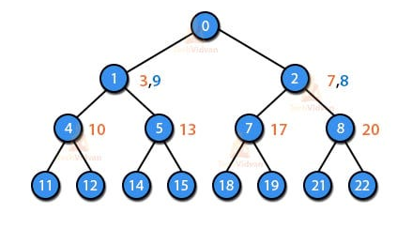
4. Iterative Deepening Depth First Search
Iterative Deepening Depth First Search (IDDFS) is a search algorithm that combines the space-efficiency of DFS with the completeness and optimality of BFS.
It works by repeatedly running Depth-Limited Search (DLS) with increasing depth limits until the goal is found. Instead of exploring deeply and possibly getting stuck (like DFS), IDDFS:
  Explores to depth 1
  Then to depth 2
  Then to depth 3, and so on Each time, it starts a new DFS but only goes down to the current depth limit.
This ensures:
  Completeness (like BFS)
  Low memory usage (like DFS)

Slide 29
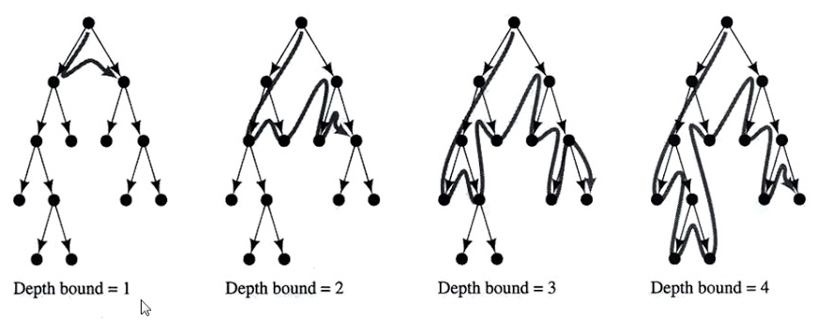
4. Iterative Deepening Depth First Search
How It Works (Step-by-Step)
  Start with a depth limit = 0.
  Perform Depth-Limited Search (DLS) up to that limit.
  If the goal is not found:
    Increase the depth limit by 1.
    Repeat the DLS process.
  Stop when the goal node is found or the search space is exhausted.

Slide 30
4. Iterative Deepening Depth First Search
Advantages
  Complete: Always finds a solution if one exists.
  Optimal: Finds the shortest path (like BFS) when all edge costs are equal.
  Space-Efficient: Requires only O(b × d) space (like DFS).
  Good for large/deep search trees.
Disadvantages
  Repetitive work: Nodes near the top are explored multiple times.
  Not ideal if solution is deep or step costs vary.
  Inefficient for infinite or cyclic graphs without visited checks.

Slide 31
4. Iterative Deepening Depth First Search
Real-Life Applications
  Used in AI-based game playing (like Chess, Checkers, or Go) where the depth of the solution is not known in advance — allows gradual deepening for better decisions.
  Applied in robot path planning when the target location is unknown or variable — helps robots explore efficiently without running out of memory.
  Common in route finding problems, such as maps or GPS systems, where the destination may be unknown or discovered dynamically.
  Useful in search-based AI planning (e.g., STRIPS, automated reasoning) to progressively explore possible action sequences.
  Used in state-space search problems such as 8-puzzle or 15-puzzle, where solutions exist at unpredictable depths.
  Used in web crawling and tree-like data exploration, where the depth of content hierarchy is unknown.

Slide 32
Uniform Cost Search

Slide 33
5. Uniform Cost Search
Uniform Cost Search (UCS) is a search algorithm that expands the least-cost node first, rather than the lowest node (like BFS).
It guarantees finding the optimal (lowest cost) path to the goal if all step costs are non-negative.
UCS is basically a Breadth-First Search with costs, where the priority is given to path cost instead of depth.
Imagine you’re finding the cheapest route between two cities on a map. You don’t just look for the shortest number of roads, but the least total travel cost (distance or time). That’s what UCS does, it always picks the path with the smallest accumulated cost so far.

Slide 34
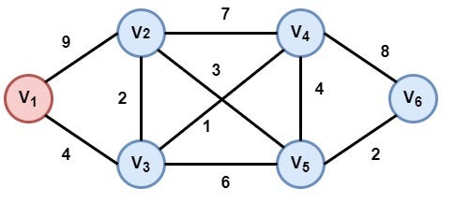
5. Uniform Cost Search
Working Principle
  Start from the root node.
  Maintain a priority queue (min-heap) where priority = path cost (g(n)).
  At each step, expand the node with the lowest cost.
  Add successors to the queue with their cumulative path costs.
  Stop when the goal node is reached — this guarantees the minimum cost path.

Slide 35
5. Uniform Cost Search
Advantages
  Always finds the optimal (least-cost) path.
  Works with different step costs, unlike BFS.
  Guarantees solution if one exists.
Disadvantages
  Slow if many small-cost paths exist.
  High memory usage due to the priority queue.
  Not efficient for extremely large or infinite graphs.
Real-Life Applications
  GPS Navigation systems (Google Maps, Apple Maps)
  Network routing protocols (finding cheapest path)
  Robot path planning

Slide 36
5. Uniform Cost Search (Example 1)

Slide 37
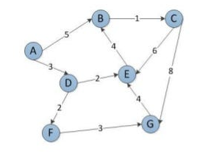
5. Uniform Cost Search (Example 2)

Slide 38
Bidirectional Search

Slide 39
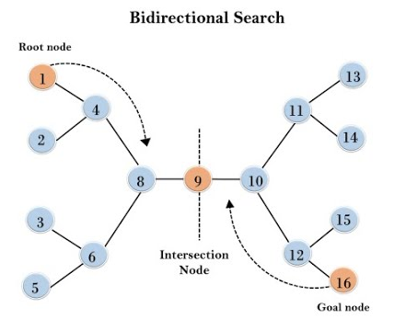
6. Bidirectional Search
Bidirectional Search is a graph search algorithm that runs two simultaneous searches:
  one forward from the start node, and
  one backward from the goal node.
  The search stops when the two meet in the middle — drastically reducing the total number of nodes explored.
Instead of exploring the entire path from start to goal in one direction (like BFS or DFS), Bidirectional Search cuts the search effort almost in half by working from both ends simultaneously.

Slide 40
6. Bidirectional Search
Working Principle
Start two searches:
  One forward from the start node (S)
  One backward from the goal node (G)
Expand both searches level by level (using BFS or UCS depending on cost).
After every expansion, check whether any node is common between both frontiers.
When they meet, combine the two partial paths to get the complete solution path.

Slide 41
6. Bidirectional Search
Advantages
  Faster than BFS or DFS for large graphs
  Saves time by exploring from both ends
  Can be optimal if both searches use BFS with equal edge costs
Disadvantages
  Needs goal state to be known in advance
  Hard to trace back the path unless both searches store parent nodes
  Space requirement is still large (storing both frontiers)
  Not efficient for problems with multiple or unknown goals

Slide 42
6. Bidirectional Search
Applications of Bidirectional Search
  Used in GPS navigation systems to find the shortest or fastest route between two known locations.
  Applied in robot path planning to save time and energy by searching from both the start and goal positions.
  Helps in computer network routing to discover the lowest-cost or least-delay communication path.
  Used in AI games and puzzles (like the 8-puzzle or chess) to find optimal solutions faster.
  Helps in social network analysis to find the minimum degree of connection between two users.
  Used in database query optimization for efficient data retrieval between related tables.
  Useful in automated planning systems where both the initial and goal states are defined.
  Reduces overall search time by meeting in the middle, making it efficient for large problem spaces.

Slide 43

Not included in Syllabus
If you were taking a nap, wake up… the lecture is over!

Slide 44

Recap
Time Complexity and Space Complexity
Uninformed Search Algorithms:
  Breadth First Search (BFS)
  Depth First Search (DFS)
  Depth Limited Search
  Iterative Deepening Depth First Search.
  Uniform Cost Search
  Bidirectional Search

